Slide 1
Design Patterns
Presenter: Artur Miarczyński
Date: 29.04.2025

Slide 2

Design Patterns
GANG OF FOUR, DESIGN PATTERNS
Structural: Composite, Proxy
Behavioral: Visitor, Chain of responsibility
MICROSERVICES PATTERNS
Circuit Breaker
Event Sourcing

Slide 3

Structural design patterns
Structural patterns focus on how objects and classes are organized and combined to create larger, flexible structures.

Slide 4
Composite – usage
The Composite pattern allows you to treat single objects and compositions of objects in a uniform way by defining a common interface. It reflects the part-whole hierarchy. It allows you to build tree-like structures of objects. It allows you to treat objects and their groups in the same way.
Used mainly in:
Graphical applications
Schema Editors
Hierarchical documents
Notes:
Wzorzec Composite umożliwia jednolite traktowanie pojedynczych obiektów i kompozycji obiektów poprzez zdefiniowanie wspólnego interfejsu.
Odzwierciedla hierachię część - całość. Pozwala budować drzewiaste struktury obiektów. Pozwala traktować obiekty i ich grupy w taki sam sposób.
Zastosowanie:
Aplikacje graficzne
Edytory schematów
Dokumenty hierachiczne

Slide 5
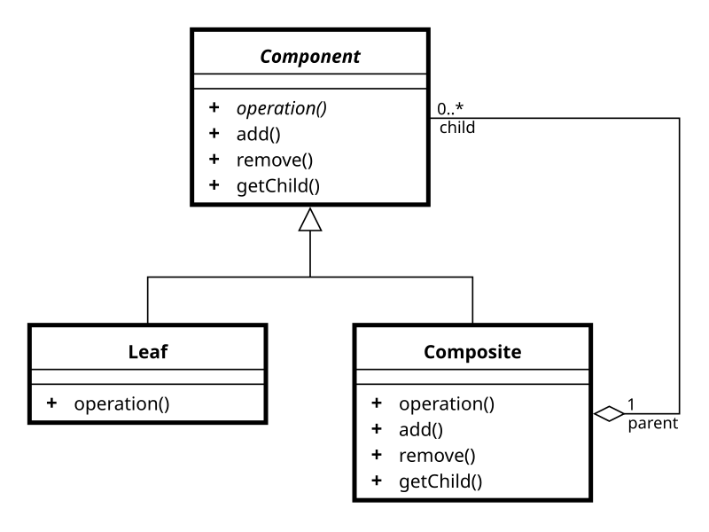
Composite - diagram
Notes:
Kluczowym element – klasa abstrakcyjna, która reprezentuje zarówna pojedynczy element jak I zawiejącay kontener.
Wspólny interfejs obiektów w hierachi np. IDrawable.Draw(). Kontener iteruje po dzieciach I na
Każdym zagnieżdzonym obiekcie woła Draw(), dopiero liść ma metodę rysującą.
Przykład z .NET XDocument – tu bazą jest XObject, kontenery Xcontainer: XDocument, XElement.
XDocument wystawia jeszcze interfejs do zapisywania i wczytywania dokumentu. Takim osobnym dzieckiem co jest XObject jest XAttribute.
Tu nie ma tak typowo obiektu liścia. Każdy może mieć dalej dzieci.
Powiązane wzorce:
Kiedy prorytetem jest rozwiązania optymalne pod względem użycia pamięci - współużytkowanie komponentów w celu oszczędzenia pamięci - Wzorzec Pyłek
Kiedy klasa Composite potrzebuje przechowywać elementy w określony sposób, np. Konkretnej kolejności - Wzorzec Iterator

Slide 6
Composite - examples

Slide 7
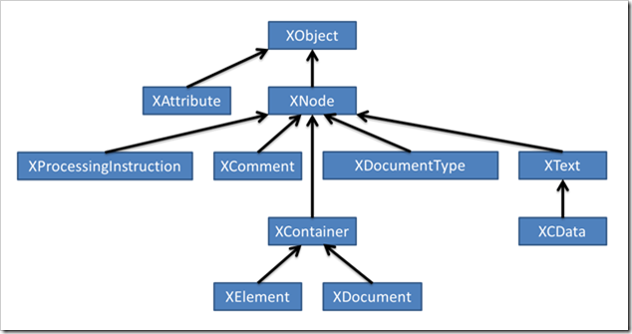
Composite – Xdocument implementation
Notes:
Problem I – obiekt liścia ma inny interfejs niż obiekt kontenera
Liść - obiekt, który nie może mieć dzieci. Dalej może mieć metodę zwracająca dostęp do dzieci, zwróci po prostu pustą kolekcję.
Co z metodami do zarządzania dziećmi? Np. Add, Remove
Remove można by rozwiązać jakby dziecko miało referencje do rodzica, wtedy mogłoby, by się usuwać z rodzica
Add – pozostaje gupie I puste
Można by po prostu dać każdemu elementowi w hierachi property i po prostu tam gdzie nie ma dzieci zwracać pustą kolekcje. Trzymanie niepotrzebnej referencji zajmuje bez sensu pamięć.
Najzdrowiej jednak zrobić osobną bazę na component i container
W XML’ u w C# rozwiązali to tak: XAttribute ->
Problem II – czyszczenie pamięci. Od roota wdół I zacząć od najniższym elementów - tu problem – co jeśli elementy liścią są współużytkowane?

Slide 8

Proxy
Proxy provides a placeholder that controls access to another object.
Similar patterns: Decorator, Adapter – similar implementation, different use case
Use when you need to control access, add lazy loading, caching, or remote access to an object.
Notes:
Zdalny pełnomocnik: najczęściej lokalny reprezentant obiektu – wysyłają rzeczywiste żądania na zewnątrz – ukrywa to, że logika danego obiektu żyje gdzieś poza systemem
Wirtualny: kiedy utworzenie obiektu pod spodem jest kosztowne – może mnie właściwości pomocnicze, np. rozmiar obrazu pod spodem - optymalizacja
Zabezpieczający: dodaje wartstwę sprawdzającą prawa dostępu – czy dany nadawca ma uprawnienia/autoryzacji – bezpieczeństwo.
Obazek z dupy – wygenerowany.

Slide 9
Proxy types
Virtual Proxy - Lazy loading (e.g., loading large objects on demand in Entity Framework)
Protection Proxy - Access control (e.g., checking permissions before allowing access)
Remote proxies (e.g., gRPC, WCF service proxies)
Caching proxies (e.g., returning cached data instead of fetching fresh)

Slide 10
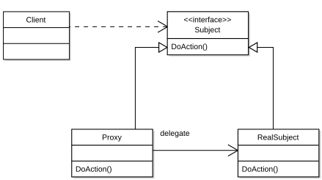
Proxy Diagram

Slide 11
Proxy - examples
Notes:
WCF – remote, protection proxy
Co do protection to dobrze to by grało z DI
Można by wyciągnąć gdzieś inicjalizacje kierowcy, nie zmieniać implementacji, która korzysta z samochodu

Slide 12
Behavioral design patterns
Behavioral patterns define how objects communicate, collaborate, and assign responsibilities.

Slide 13

Visitor
You need to extend a group of objects, but you don’t want to modify their implementation.
Add external logic (e.g., XML parsing) without polluting the class’s main responsibility.
Visitor is very powerful when you have a stable hierarchy (the elements rarely change), but operations on them change often (If element types change often, Visitor becomes costly because every Visitor must be updated.)
Notes:
Operational design pattern, represents operation being executed on elements of object structure. It allows to extend the functionality without modifying the class it operates on.
This pattern works on two abstractions: Node and NodeVisitor. Visitor is specific to a Node, need to know about the type.
You actually have to extend your object but the change is minimal -> accept method implementation.
Without Visitor we would need to check all subtypes during runtime.

Slide 14
Vistor – use case
Expression tree processing (e.g., ExpressionVisitor in LINQ, Entity Framework)
AST traversal in compilers/interpreters (e.g., Roslyn)
Document exporting (e.g., to HTML, XML, PDF formats)
UI rendering engines or element inspectors

Slide 15
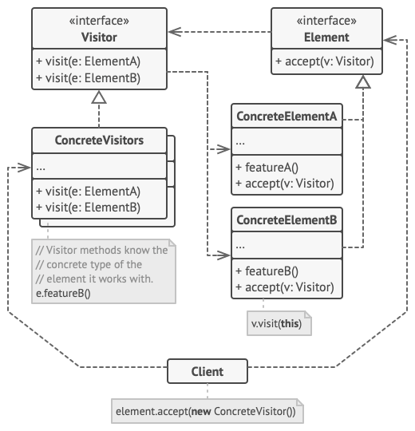
Visitor
Notes:
The Visitor interface declares a set of visiting methods that can take concrete elements of an object structure as arguments. These methods may have the same names if the program is written in a language that supports overloading, but the type of their parameters must be different.
Each Concrete Visitor implements several versions of the same behaviors, tailored for different concrete element classes.
There are actually two options only:
either implement simple accept method, copy-paste
reflection-based Visit in the abstract base method for node (bad)
dynamic-based abstract method for node base (bad)
REMEMBER: you can reuse the same interface for other visitors if you need to implement additional logic, then you don’t need to modify accept method at all.

Slide 16
Visitor - Examples
In Entity Framework Core, when you write a LINQ query, EF needs to translate that C# LINQ expression into a SQL query.
To do that, EF Core:
Receives your LINQ Expression (like Expression<Func<User, bool>>)
Walks the Expression Tree to understand what operations you're performing (e.g., Where, Select, OrderBy)
Translates it into SQL.
The class that walks and transforms the expression tree is a subclass of ExpressionVisitor.
https://github.com/dotnet/efcore/blob/main/src/EFCore.Relational/Query/RelationalSqlTranslatingExpressionVisitor.cs
https://github.com/microsoft/referencesource/blob/master/System.Core/System/Linq/Expressions/ExpressionVisitor.cs
Notes:
In Entity Framework Core, when you write a LINQ query, EF needs to translate that C# LINQ expression into a SQL query.
To do that, EF Core:
Receives your LINQ Expression (like Expression<Func<User, bool>>)
Walks the Expression Tree to understand what operations you're performing (e.g., Where, Select, OrderBy)
Translates it into SQL.
The class that walks and transforms the expression tree is a subclass of ExpressionVisitor.
https://github.com/microsoft/referencesource/blob/master/System.Core/System/Linq/Expressions/ExpressionVisitor.cs

Slide 17
Chain of responsibility
when more than one object can handle the request, but it is not known which one, it resolves automatically
If you want to send the request to one of the objects without specifying which one should handle it
group of objects that can handle the quest is created dynamically

Slide 18
Chain of responsibility – example usage
Middleware pipelines (e.g., ASP.NET Core middleware)
Event handling systems (e.g., GUI frameworks like WPF/WinForms)
Logging frameworks (e.g., multiple loggers chained together)
Validation chains

Slide 19
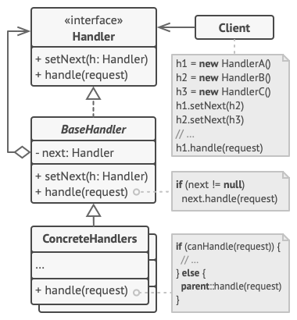
Chain of responsibility
Notes:
The Handler declares the interface, common for all concrete handlers. It usually contains just a single method for handling requests, but sometimes it may also have another method for setting the next handler on the chain.
The Base Handler is an optional class where you can put the boilerplate code that’s common to all handler classes.
Usually, this class defines a field for storing a reference to the next handler. The clients can build a chain by passing a handler to the constructor or setter of the previous handler. The class may also implement the default handling behavior: it can pass execution to the next handler after checking for its existence.

Slide 20
Chain of responsibility – examples

Slide 21
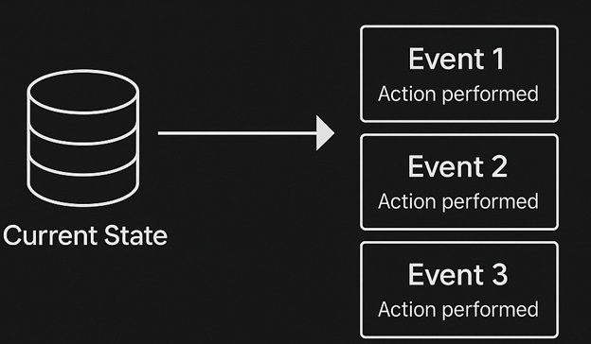
Event Sourcing
Instead of storing only the current state, store all changes (events) that led to the current state.
Store every change (event) like "OrderPlaced", "EmailChanged", "PaymentCompleted".

Slide 22
Event Sourcing – Why?
Performance - Writing an event is just appending a record to the end of the log - no expensive joins, updates or deletes. This makes write latency predictable and very low. Since you’re not touching existing rows, you avoid locking hot spots; many writers can append concurrently with almost no coordination.
Scalability - Because each write is just an append, write endpoints don’t need to maintain rich, in-memory state—making them easy to scale out.
Auditability - Every state change is stored as an event and never overwritten or deleted. This guarantees you can see exactly what happened and when. You can reconstruct the full application state as of any timestamp by replaying events up to that moment. This lets auditors verify what the system looked like at key moments (e.g., end of quarter, just before a suspected breach).
Notes:
The CRUD approach is straightforward and fast for most scenarios. However, in high-load systems, this approach has some challenges:
Performance: As the system scales, the performance will degrade due to contention for resources and locking issues.
Scalability: CRUD systems are synchronous and data operations block on updates. This can lead to bottlenecks and higher latency when the system is under load.
Auditability: CRUD systems only store the latest state of the data. Unless there's an auditing mechanism that records the details of each operation in a separate log, history is lost.
Data is stored as an Event Store – series of events instead of storing the latest state. Each event is an operation that modifies state like: AddedItemToOrder, OrderCanceled.
To materialize the state you need to rebuild the object from the beginning. Get a raw version and apply all the events in order.
Because it is relatively expensive to read and replay events, applications typically implement materialized views, read-only projections of the event store that are optimized for querying. For example, a system can maintain a materialized view of all customer orders that's used to populate the UI. As the application adds new orders, adds or removes items on the order, or adds shipping information, events are raised and a handler updates the materialized view.
If an aggregate has thousands of events, you can occasionally write a snapshot of its state. On load, you start from the snapshot and replay only the recent events—dramatically cutting load time.

Slide 23
Event Sourcing – use cases
Financial Systems & Payment: Ledger & Transaction History, regulatory compliance
Order Management & E-commerce: Shopping Carts & Orders, Returns & Refunds
Collaborative & Multi-User Applications: Document Editing / Collab Tools, Workflow Engines
Auditing & Regulatory Reporting: Immutable Audit Logs, Time-Travel Queries
ETC…
Notes:
Financial Systems & Payments
Ledger & Transaction History Every debit, credit, fee, or reversal is an immutable event. You can reconstruct account balances at any point, generate audit trails, and detect anomalies.
Regulatory Compliance Requirements like SOX or PCI-DSS demand full traceability of who did what when—it’s automatic with event sourcing.
2. Order Management & E-commerce
Shopping Carts & Orders Track “ItemAdded,” “ItemRemoved,” “OrderPlaced,” “PaymentCaptured,” “OrderShipped,” etc. to understand exactly how an order evolved.
Returns & Refunds Model “ReturnInitiated” and “RefundIssued” events to maintain a clear, time-stamped sequence.
3. Collaborative & Multi-User Applications
Document Editing / Collab Tools Each user edit (insert, delete, format change) is an event—enables real-time collaboration, conflict resolution via CRDT–style merging, and “undo”/“history” features.
Workflow Engines State transitions (“TaskAssigned,” “TaskCompleted,” “ApprovalGranted”) are events that drive downstream processes and notifications.
4. IoT & Sensor Data Streams
Telemetry Ingestion Each sensor reading (temperature, humidity, location ping) is an event you can stream, aggregate, and replay for diagnostics or machine-learning training.
Device State Changes Model “DeviceOnline,” “DeviceOffline,” “FirmwareUpdated” to trace device health and rollback problematic updates.
5. Gaming & Leaderboards
Player Actions & Achievements Store “LevelUp,” “ItemAcquired,” “ScoreUpdated,” “MatchStarted,” “MatchFinished” events to build replays, analytics, and fair leaderboards.
Rollback & Replay In case of bugs or exploits, you can rewind game state to before the issue and replay only valid events.
6. Customer 360 & CRM Systems
Customer Interactions “EmailOpened,” “LinkClicked,” “PurchaseMade,” “SupportTicketCreated” events feed into a unified timeline of customer behavior.
Real-time Segmentation As events stream in, you update read-models for marketing, support, or sales dashboards.
7. Complex Domain-Driven Designs
Aggregates with Rich Behavior Entities like “LoanApplication” or “InsuranceClaim” have many possible state transitions. Modeling each as an event makes the business logic explicit and traceable.
Policy Changes Over Time If business rules evolve, you can replay past events under new logic for recalculation or reporting.
8. Auditing & Regulatory Reporting
Immutable Audit Logs Regulatory bodies often require indelible logs of system changes—event sourcing provides that by design.
Time-Travel Queries Generate “as-of” reports for any historical date with no extra effort.

Slide 24
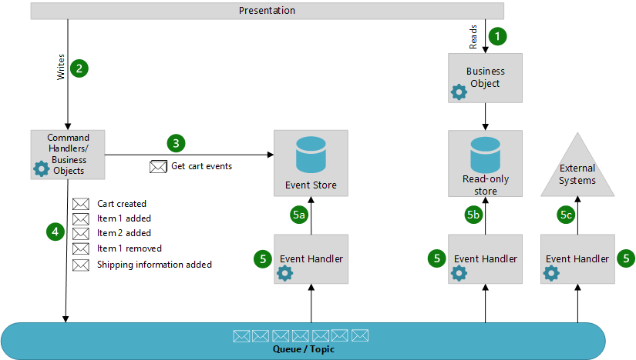
Event Sourcing – Sample workflow
Notes:
Workflow
The following describes a typical workflow for this pattern:
The presentation layer calls an object responsible for reading from a read-only store. The data returned is used to populate the UI.
The presentation layer calls command handlers to perform actions like create a cart, or add an item to the cart.
The command handler calls the event store to get the historical events for the entity. For example, it may retrieve all cart events. Those events are played back in the object to materialize the current state of the entity, prior to any action taking place.
The business logic is run and events are raised. In most implementations, the events are pushed to a queue or topic to decouple the event producers and event consumers.
Event handlers listen for events they are interested in and perform the appropriate action for that handler. Some typical event handler actions are:
Writing the events to the event store
Updating a read-only store optimized for queries
Integrating with external systems

Slide 25
Event Sourcing – sample implementation

Slide 26
Event Sourcing – 3rd party solutions
OpenSource DB for Event Sourcing - EventStoreDB -> https://www.kurrent.io/ currently https://github.com/kurrent-io/KurrentDB (db, sdks + managed cloud service).
Marten - https://martendb.io/ - implementation based on PostgreSQL
NEventStore - A lightweight .NET library for Event Sourcing, Pluggable storage (SQL, RavenDB, MongoDB)
Akka.NET (with Event Sourcing plugin)

Slide 27
Event Sourcing – Well-architected Framework Pillars
Reliability - Due to capturing a history of changes in complex business process, it can facilitate state reconstruction if you need to recover state stores.
Performance Efficiency - This pattern, usually combined with CQRS, an appropriate domain design, and strategic snapshotting, can improve workload performance due to the atomic append-only operations and the avoidance of database locking for writes and reads.

Slide 28
Event Sourcing - downsides
Simple CRUD might be good enough.
Introduce a lot of complexity, enforce the system around to be build around this pattern. It is very difficult to redesign it.
https://learn.microsoft.com/en-us/azure/architecture/patterns/event-sourcing#issues-and-considerations
Notes:
Event Sourcing is a complex pattern that permeates through the entire architecture and introduces trade-offs to achieve increased performance, scalability, and auditability. Once your system becomes an event sourcing system, all future design decisions are constrained by the fact that this is an event sourcing system. There is a high cost to migrate to or from an event sourcing system. This pattern is best suited for systems where performance and scalability are top requirements. The complexity that event sourcing adds to a system is not justified for most systems.

Slide 29
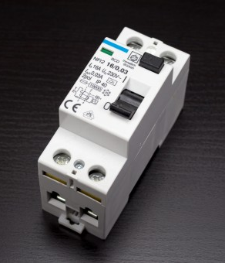
Circuit Breaker – Why do I need this?
Circuit Breaker temporarily blocks operations to a failing service, giving it time to recover instead of letting repeated failures degrade the system.
Protects against transient service errors (temporary unavailability).
Prevents repeated failed calls by opening the circuit and failing fast.
Works well with Retry, Timeout, and other resilience patterns.
Use when a service may fail intermittently, and repeated retries would cause delays or overload the system.
Notes:
Bezpiecznik
Transient service errors (something might be temporarily unavailable). This could be handled by a retry to but what if that fails again and your service is using a bigger amount of memory? Is it efficient to wait again? What if we reached the service limit and our call will just make it worse? (For this scenario throttling could also be used).
Unlike the Retry pattern it doesn’t try to call the service again in hope that problem was just a temporary one and it should be solved if try after 10 minutes, instead it is to avoid repeating the service that will most likely fail again. Fail immediately instead of waiting for the timeout again. This pattern can be combined with the retry, but it has to be implemented in a way that it knows about circuit breaker.

Slide 30
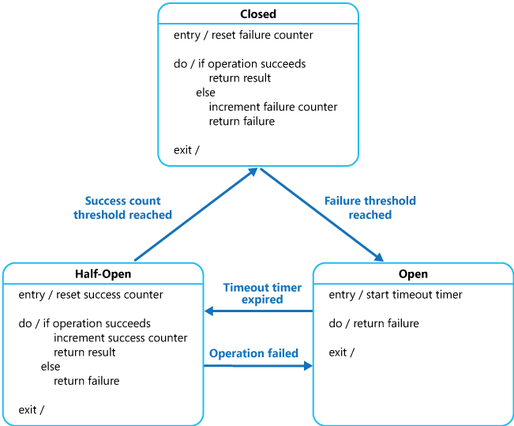
Circuit Breaker - Algorithm
Notes:
Circuit breaker acts as a proxy that decides whether the service can be called. It counts the number of the recent failures. It can be implemented as a state machine. Circuit breaker can be in one of the three states: Open, Closed, Half-Open.
Closed – routes call to the service and maintains the counter for the number of recent failures. If the number exceeds a threshold it is set to Open state and starts the timer. Proxy is set to Half-Open state after the timeout.
Open – blocks the calls, fails immediately and throws exception.
Half-Open – limited number of requests are allowed, circuit can be closed again if these requests are successful and the failure counter is reset. If any of these requests fails it switches to Open state. This state is to prevent from flooding the service that just recovered form a failure state.
+ Options increase the timeout if the problem wasn’t resolved after the first one.
+ If you really want to complicate it use adaptive thresholds and timeouts, anomaly detection, AI etc.
+ Circuit breaker could call a fallback service while it is opened.
+ It could differentiate the type of exception and handle it accordingly
+ Instead of using a timeout, circuit breaker could ping a remote service to check if it can be closed instead, it could use a health-check endpoint for that.
+ option to manually control the counter, reset the breaker and set it to open/closed by administrator.
+ concurrency – implementation shouldn’t be blocking.
+ edge case – call one single circuit breaker for a single resource, but it has multiple providers / multiple shards some are available some are not.
+ accelerate – react based on the error from the service, it might be good to setup a longer timeout if service says explicitly that it is overloaded (429 too many requests or 503 unavailable).
+ multi-region deployments – CB could be region-aware
+ service mesh (application layer for communication) circuit breakers – CB as a sidecar, standalone capability without modifying application code.

Slide 31
Circuit Braker - When you shouldn’t use it?
Manage access to private resources
Use as a replacement for handling exception in the business logic
Simpler approach might be better – retry, no need to add that much complexity to your system
Waiting for Circuit breaker to reset might cause too long delays
In message-driven or event-driven architecture – failure could be handled by dead letter queue and deferred processing.

Slide 32
Circuit Braker – example implementation

Slide 33


Circuit Breaker - Practical usage
Polly is a .NET resilience and transient-fault-handling library that allows developers to express policies such as Retry, Circuit Breaker, Timeout, Bulkhead Isolation, and Fallback.
Usage with HttpClient:
https://learn.microsoft.com/en-us/aspnet/core/fundamentals/http-requests?view=aspnetcore-9.0#use-polly-based-handlers
Library that helps to generate the failures for testing your service reliability – monkey/chaos testing.
Notes:
Uses IHttpClientFactory to inject the policies:
https://learn.microsoft.com/en-us/dotnet/architecture/microservices/implement-resilient-applications/use-httpclientfactory-to-implement-resilient-http-requests
Prepare an example – show some code.
https://pixelastic.github.io/pokemonorbigdata/

Slide 34
Circuit Breaker - Well-architected Framework Pillars
Reliability, Performance Efficiency
Reliability – helps to prevent faulting dependency from overloading
Performance Efficiency – doesn’t hold service while retrying, instead return error when the operation most likely will fail anyway

Slide 35
Thank you

